Slide 1





Team – 7 General Insurance System

Slide 2
Objective
The aim is to develop a user friendly, secure, error free online application where the user can buy insurance policies, renew them and claim the insurance. The user will also be able to read detailed yet easy to understand excerpts about different insurance policies provided by the application.
Mandatory Modules:
1. Buy insurance
2. Renew insurance (Only motor)
3. Calculate insurance estimate
4. Claim insurance

Slide 3
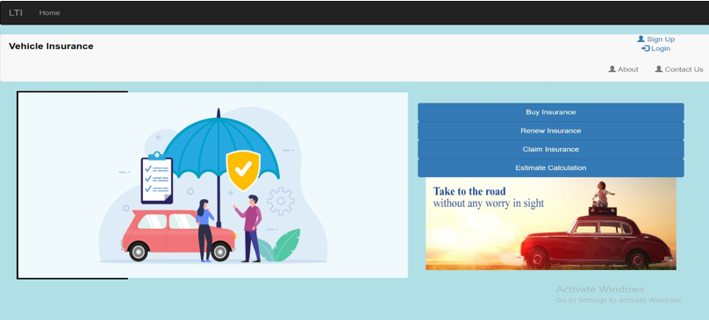
Figure 1 - Home Page : It provides the option to the user to login and buy policy , renew his / her insurance , claim the insurance amount and also estimate the insurance price.

Slide 4
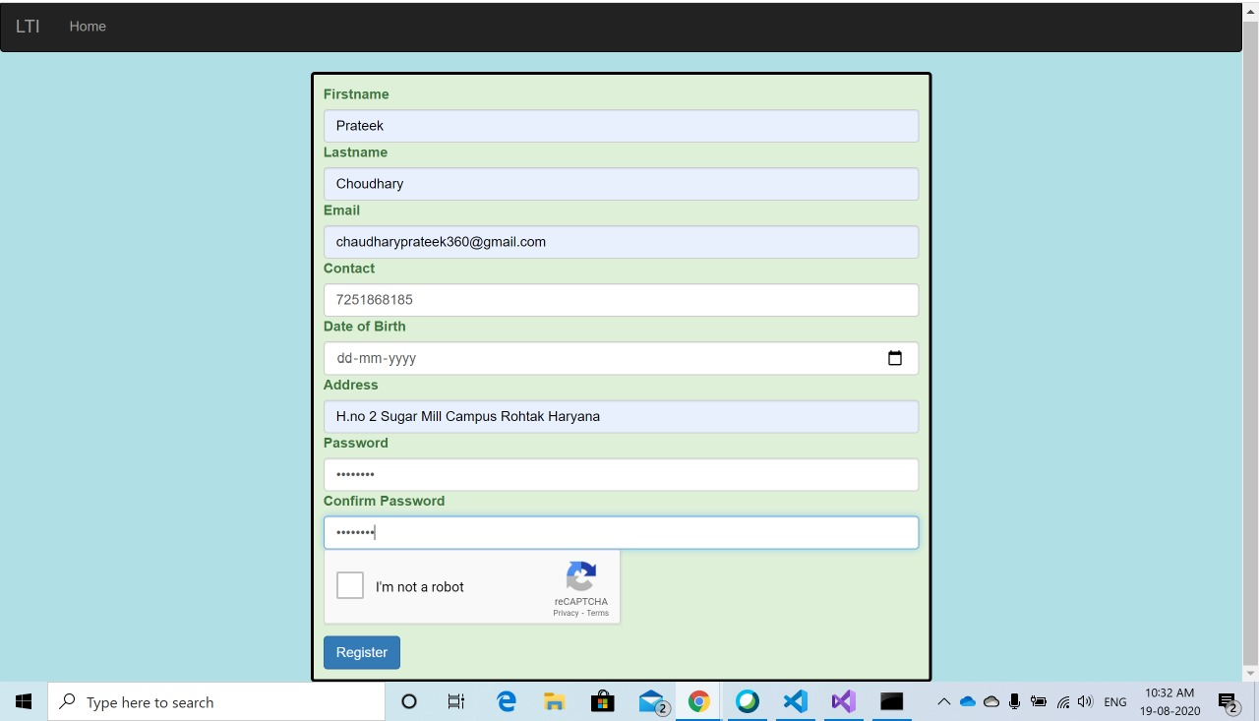
Registration: User has to register first.

Slide 5
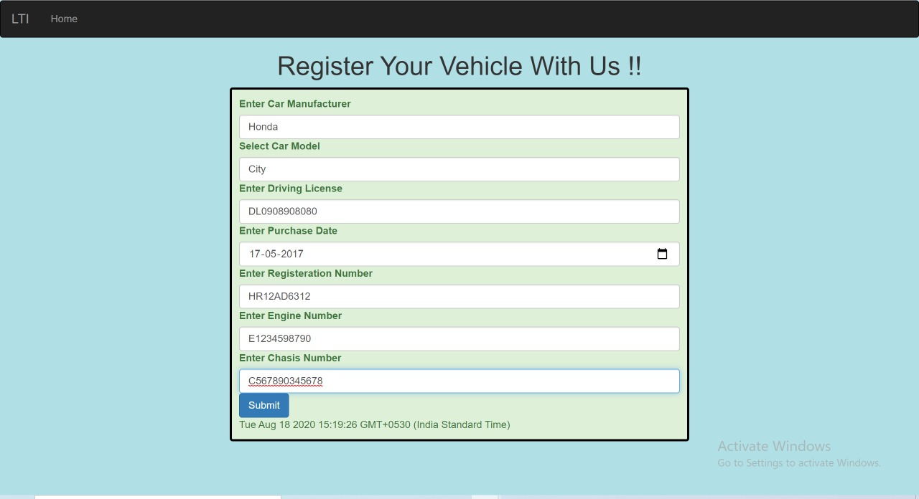
Figure 2 - Vehicle Registration : Here user will enter the details of the vehicle to get the insurance of that vehicle.

Slide 6
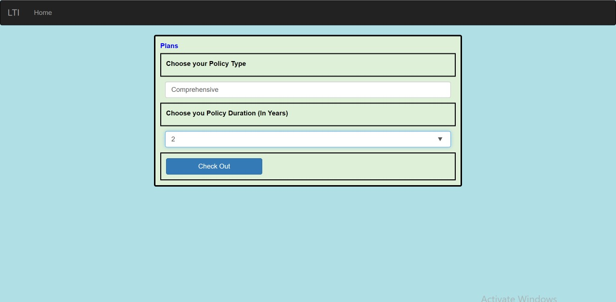
Figure 3 - Policy Plan :User will choose the policy type and policy duration to get the policy value.

Slide 7
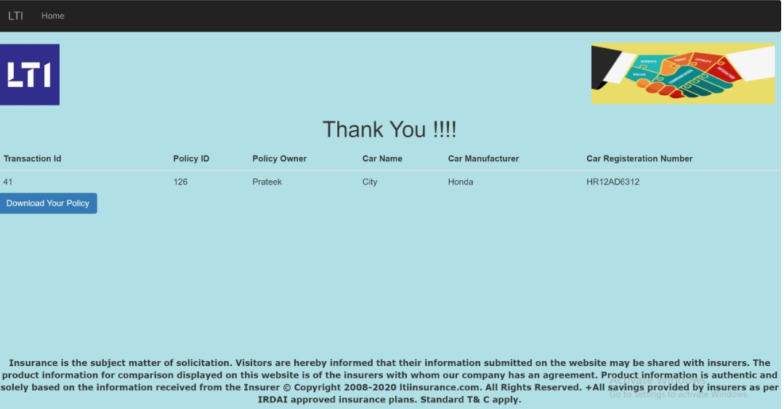
Figure 4 - User is successfully done with the vehicle insurance.

Slide 8
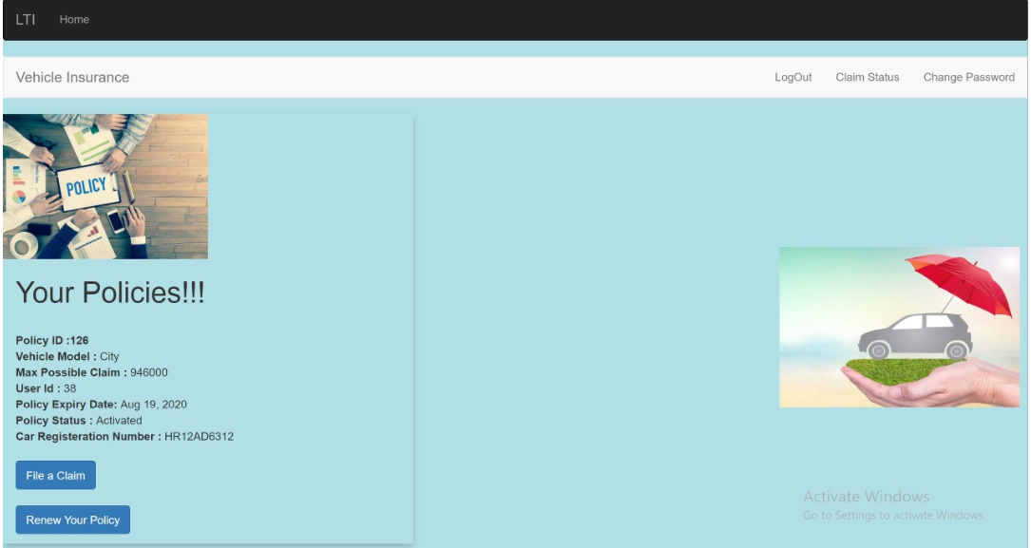
Figure 5 - User-dashboard : User can view , renew and can file the claim for the vehicle insurance policy .

Slide 9
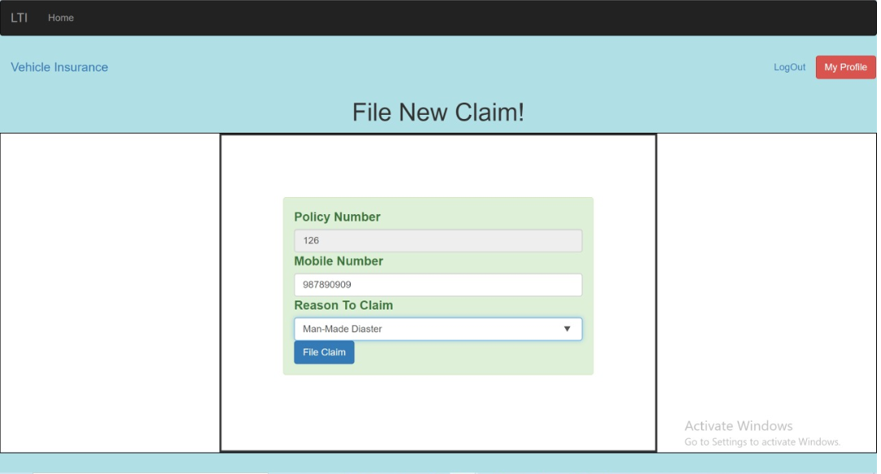
Figure 6 – File Claim : User can file the claim by providing the policy details and the reason of claim.

Slide 10
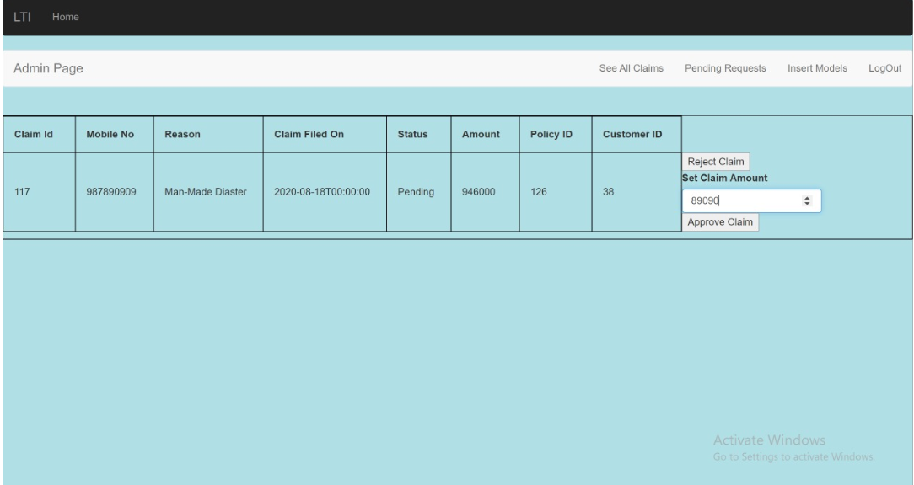
Figure 7 - Admin Page : Here Admin can approve the claim amount by taking the policy details into consideration.

Slide 11
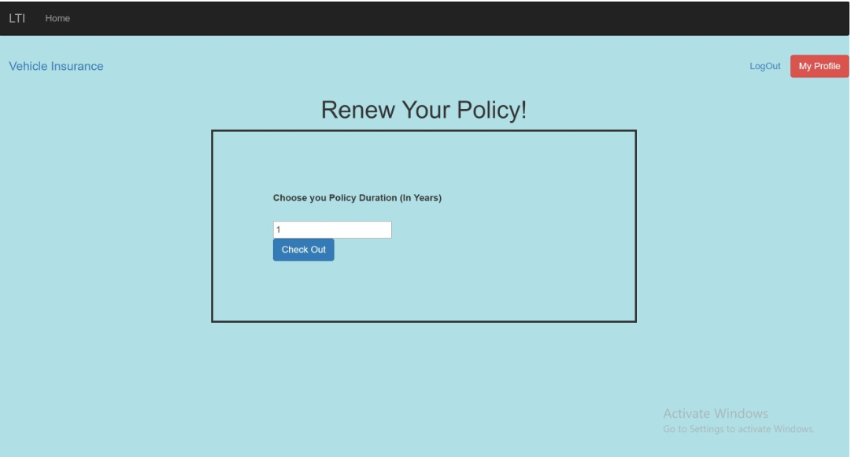
Figure 8 – Renew Policy : Here user can choose the policy details in years and hence checkout.

Slide 12
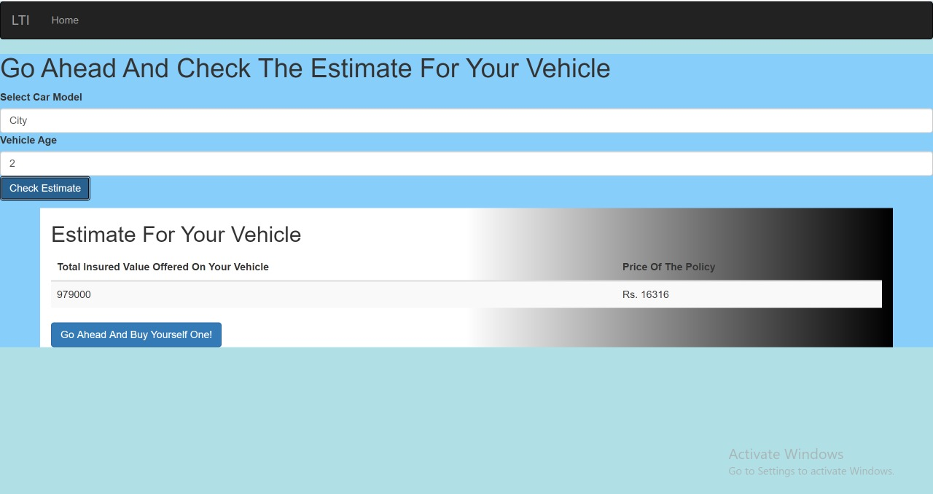
Figure 9 – Check Estimate : Here user can enter the car model and the age of the vehicle and hence check the total insured value of vehicle and also the price of the policy.

Slide 13
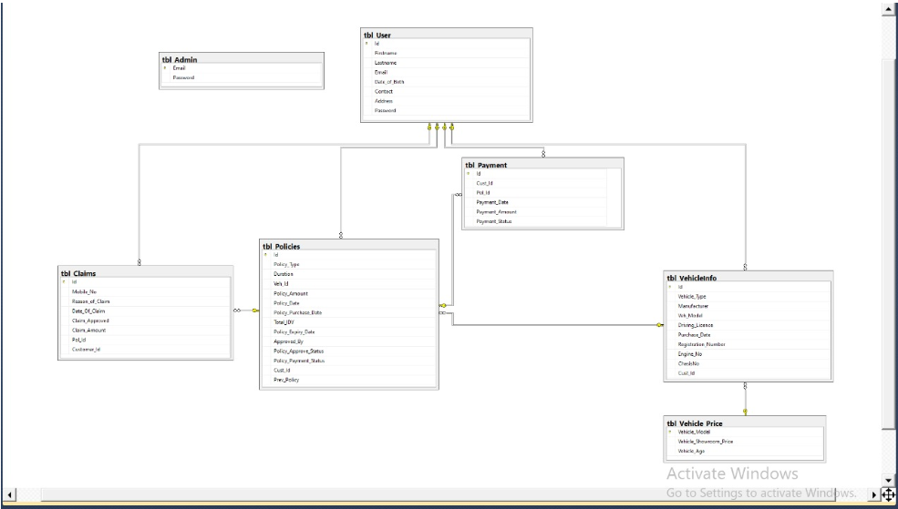
Figure 10 – Database Diagram

